Slide 1
Observer Pattern
Anthony Ferrara
CSCI 370

Slide 2
What is the observer pattern?
In software design and engineering, the observer pattern is a software design pattern in which an object, named the subject, maintains a list of its dependents, called observers, and notifies them automatically of any state changes, usually by calling one of their methods.
In my code, the “Car” class notifies two observers about changes in the price of the car, and changes in the cars year. It does this by calling the update() method, which is defined inside of an interface.
The observer pattern has many advantages. It supports the principle of loose coupling between objects that interact with each other. It allows sending data to other objects effectively without any change in the Subject or Observer classes. Observers can be added/removed at any point in time.

Slide 3
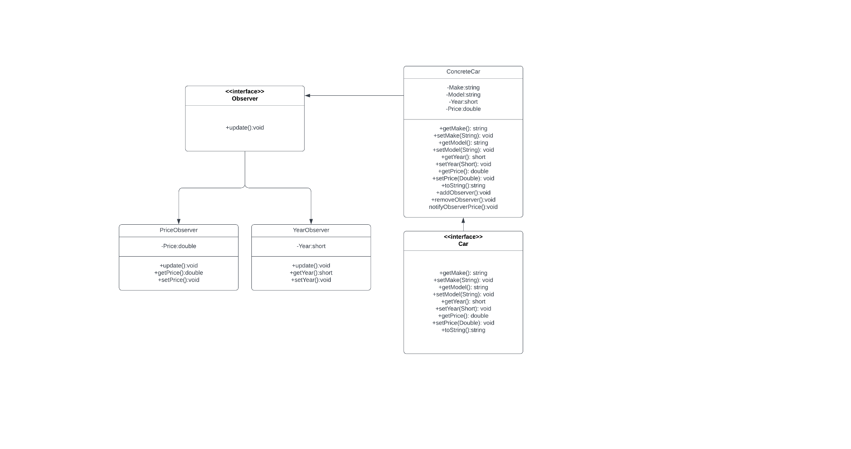
UML Class Diagram
Notes:
This diagram describes the structure of my code. The car interface is the blueprint for the concreteCar class, and it defines all the methods that it needs in order to function. The concreteCar class has 2 methods, addObserver(), removeObserver(), which it can use to keep track of all the observers it needs to send data to. The information flow begins when the notifyObserverPrice() or notifyObserverYear() method is called. These methods iterate through the arrayList of observers, and call the update() method on each observer individually, and updates the variables of each.

Slide 4
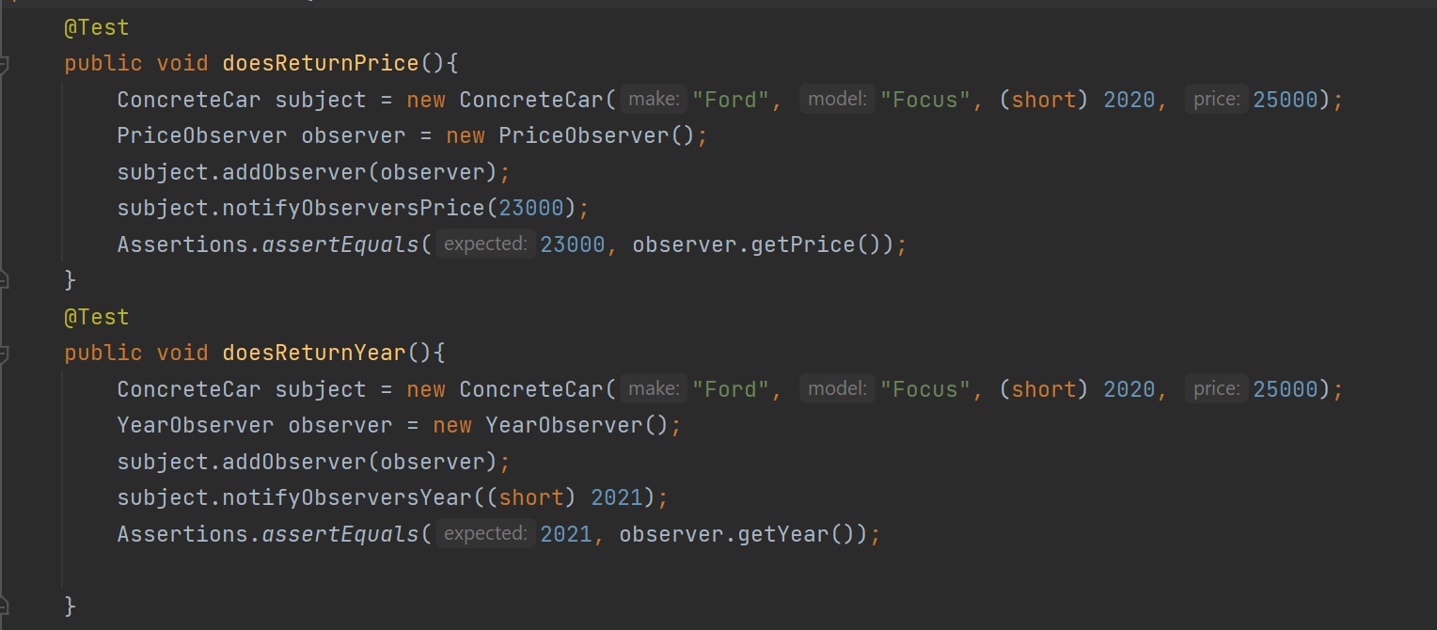
Unit Tests
Unit testing ensures that all code meets quality standards before being deployed.
The most popular testing framework for Java is JUnit5, which is what is used in this project.
The first test creates a new Car class, and adds a priceObserver to it. Then, we call the notifyObserverPrice() method, and pass in a new price, which updates the original car class, and the observers.
The second test creates a new Car class, and adds a yearObserver to it. Then, we call the notifyObserverYear() method, and pass in a new year, which updates the original car class, and the observers.

Slide 5
Component Tests
The primary objective of component testing is to validate the behavior of the individual component, as specified in the requirements document.
For this project, I have written the following component test:
Create two observer classes, one that observes the car’s year of production, and one that observes
the car’s price. When these values change, they are passed to the observers via the ConcreteCar
class. Add an instance of either observer to the array list located within the ConcreteCar class.
Then, use the getter methods located within each observer class, (priceObserver and yearObserver) to retrieve the information.

